Slide 1
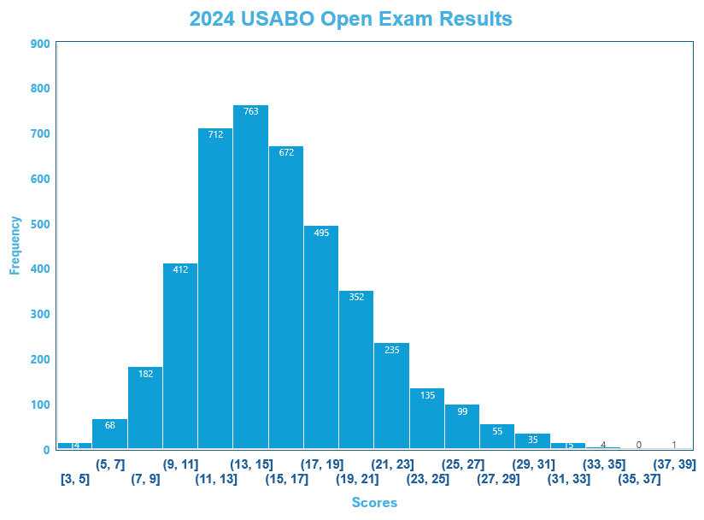
Number of scores | 4263 |  | Open Cutoff | 23
Total Points Possible | 50 |  | Average | 16
High Score | 39 |  | Median | 21
Low Score | 3 |  | Standard Deviation | 4.93

